Slide 1
NRG Stimulation 2015
Adam Pallus

Slide 2
Methods
At each location, we had three trial types
Gap-Stim-Fixation: The monkey fixates on a visual target. After a random delay, the visual target turns off and 50ms later we stimulate.
Gap-Pursuit: The monkey begins pursuing a step-ramp visual target.
Gap-Stim-Pursuit:

Slide 3
Latency Analysis
We use two methods to assess the latency of the stimulus-evoked movements.
The time when the acceleration is outside two standard deviations of non-stim trials
Fit a regression line to the stimulus-evoked acceleration and note where this line intersects with the pre-stimulus regression
The first method is simple to implement, but the estimated latency is very sensitive to variability. Because the variability is greater in the eye-movement recordings, this biases the analysis to find longer latencies for eye movements compared to head movements.
The second method allows us to set a high threshold for evoked movements and then backtrack to find when the movement started. This method is sensitive mainly variability in the stimulus-evoked movement, which is preferable.

Slide 4
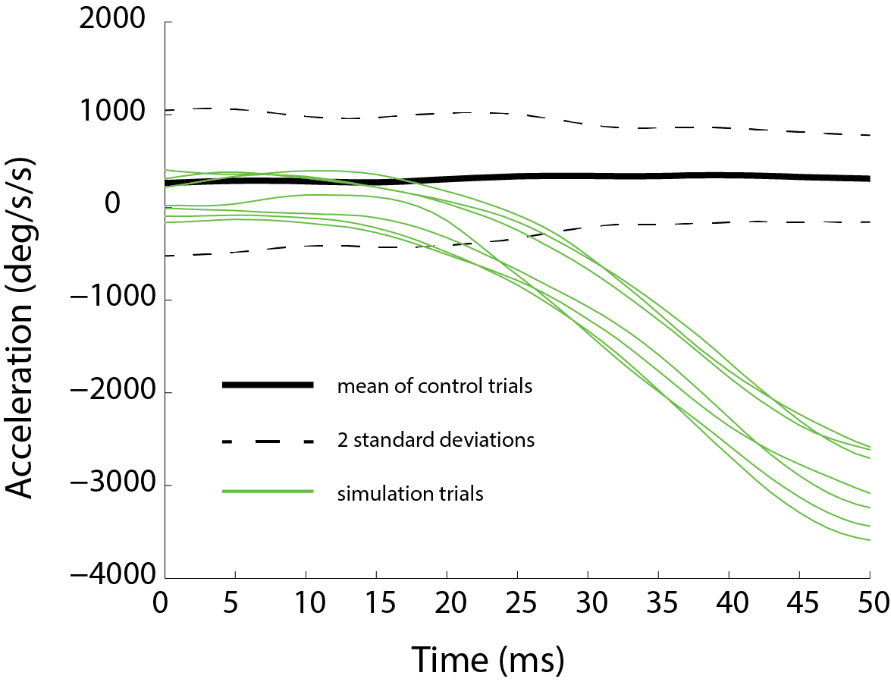
Latency Analysis: Method 1

Slide 5
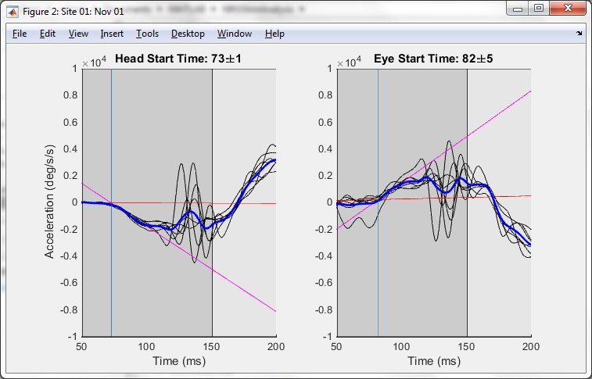
Latency Analysis: Method 2

Slide 6
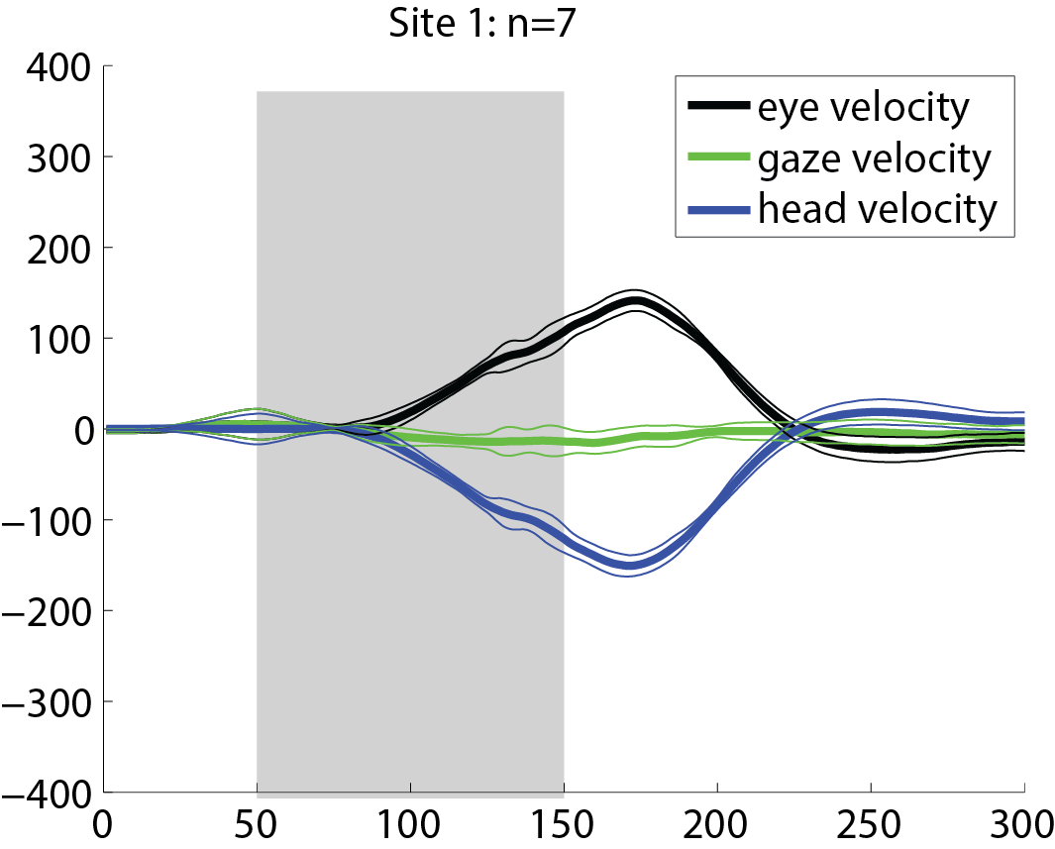
Fixation-Gap-Stim-Evoked Movements
Stimulation 50ms after disappearance of fixation target

Slide 7
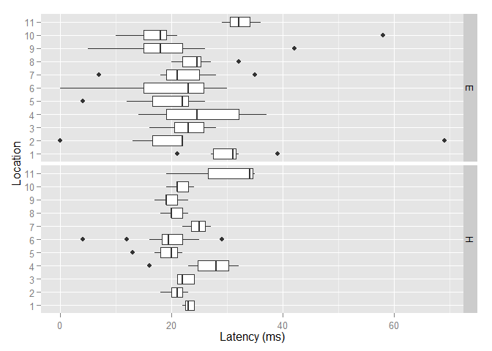
Latency of Eye and Head
At each location, the eyes and head begin moving at about the same time. There is more variance in the calculated eye latency.

Slide 8
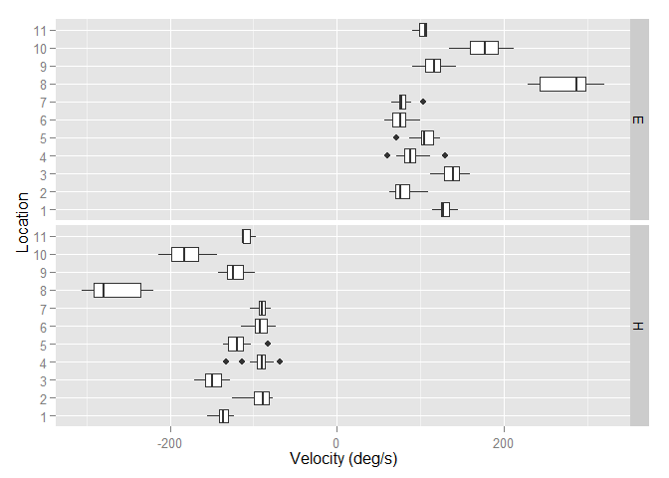
Peak Evoked Eye and Head Velocities
All 11 locations produced leftward head movements on stimulation. Location 8 produced the fasted head movements (300+ deg/s) while other sites produced movemnts between 75 and 200 deg/s.
Note that this is during 50ms post-fixation stimulation

Slide 9
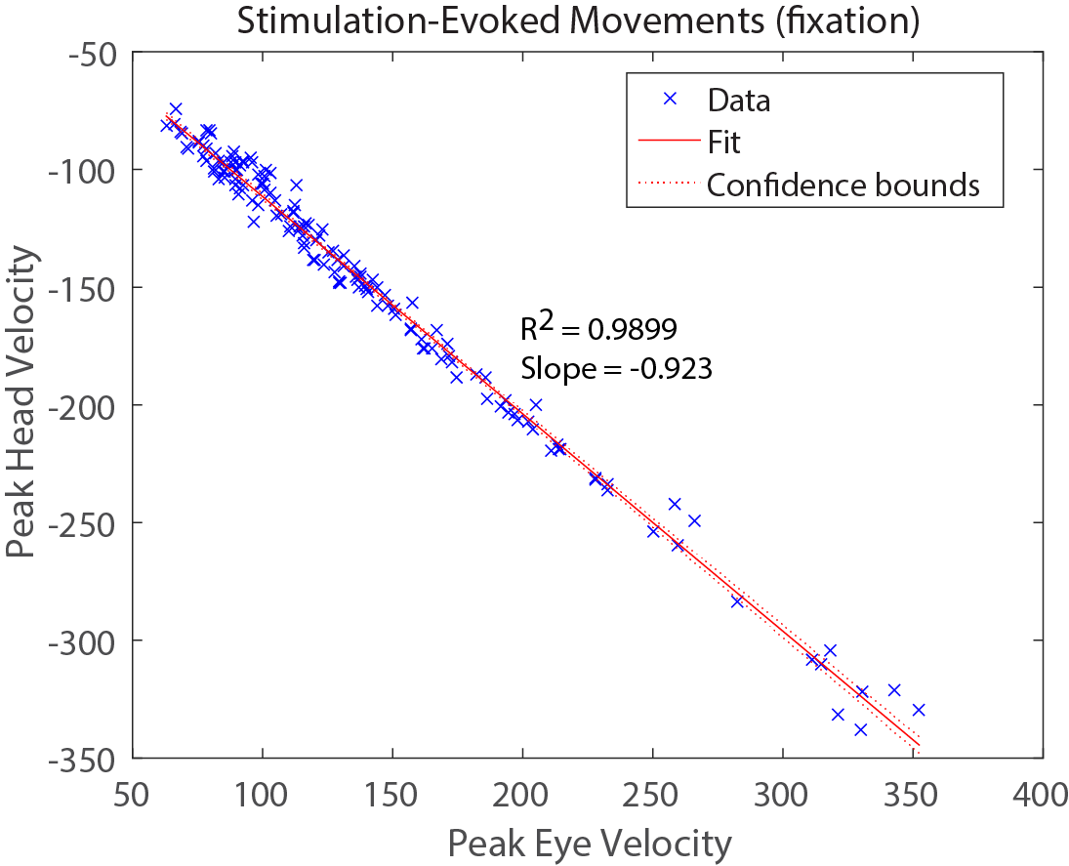
Comparison of Peak Evoked Eye and Head movements
The relationship between peak evoked head velocity and eye velocity is extremely tight. The slope of the regression is -0.916, which represents the average compensatory gain of the observed eye movements

Slide 10
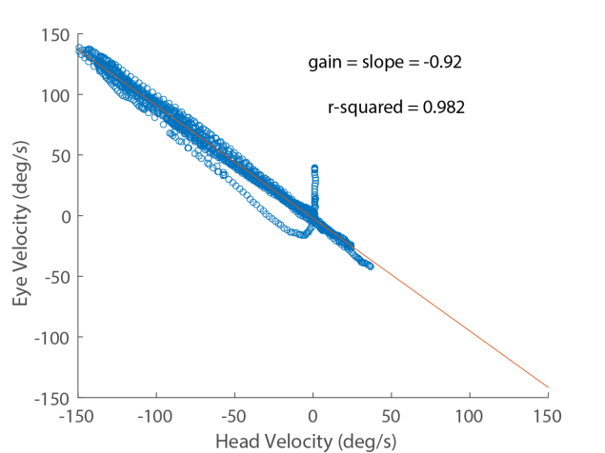
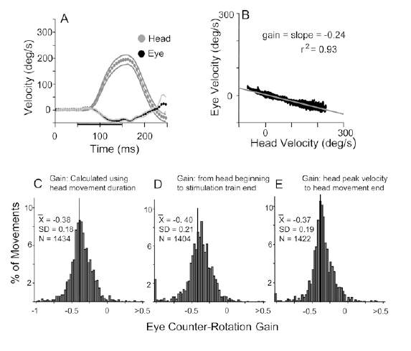
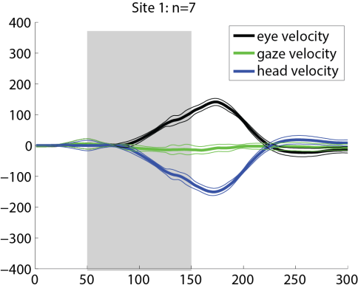
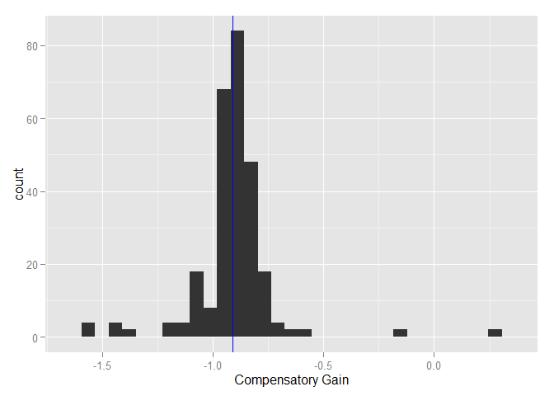
Eye Compensation (VOR)
This Study
Quessy and Freedman (2004)
Mean = -0.91
SD = 0.19

Slide 11
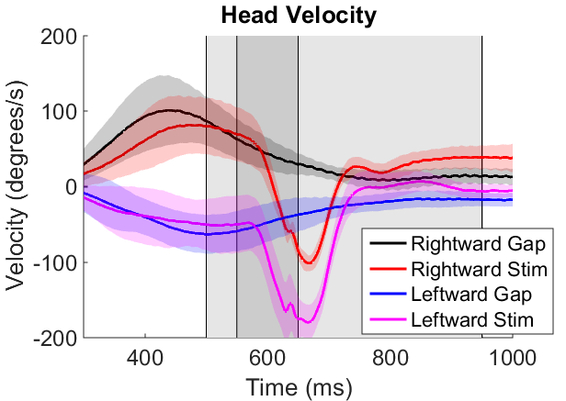
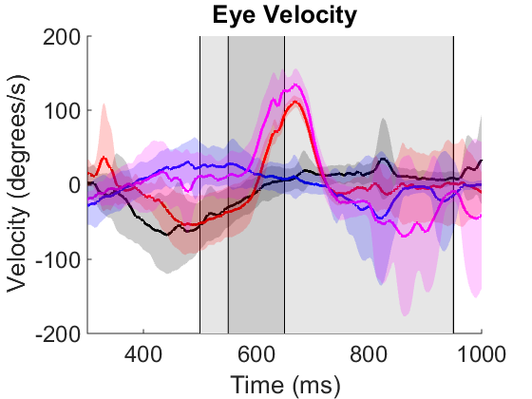
Step-Ramp-Gap-Stim

Slide 12
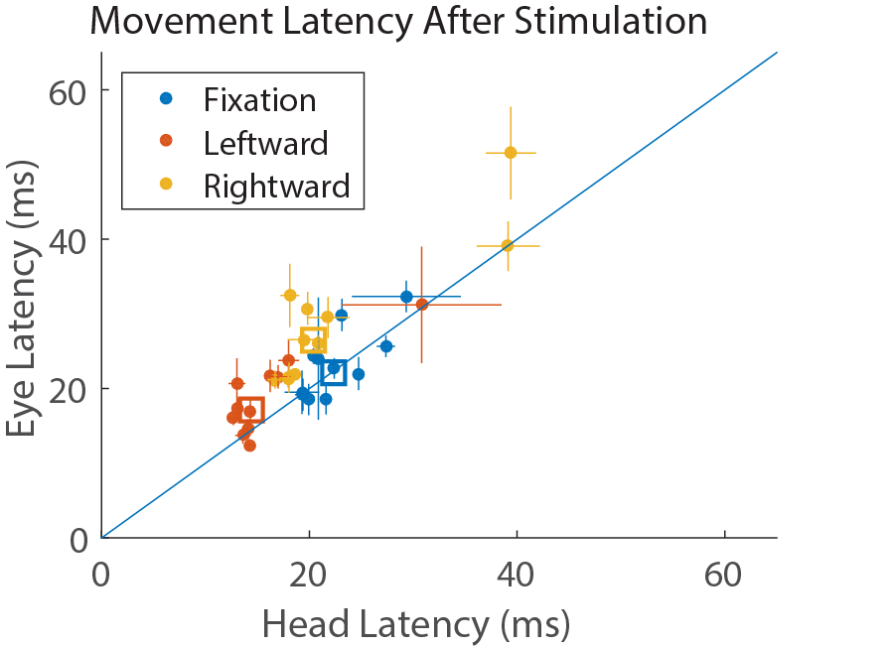
Comparing the latency of the stimulus-evoked movements during stimulation during fixation and during movements to the left and right. The open squares indicate the mean latency of each type. The line y=x is shown.
This analysis shows there is no detectable change in eye movement before the head begins to move. This is consistent with VOR as the source of the eye movements

